Slide 1
Enumeration

Slide 2
Enumeration
Attacker creates active connections to system & performs directed queries for more information
Extracted information used to identify system attack points & perform password attacks to gain unauthorized access
Conducted in an intranet environment
Enumerated Informations
Network resources
Network shares
Routing tables
Audit & Service settings
SNMP & DNS details
Machine names
Users & groups
Applications & banners
Techniques
Extract usernames using email IDs
Extract information using the default passwords
Extract usernames using SNMP
Brute force Active Directory
Extract user groups from windows
Extract information using DNS Zone Transfer

Slide 3
Services & Ports to Enumerate
TCP/UDP 53
  DNS Zone Transfer
TCP/UDP 135
  Microsoft RPC Endpoint Mapper
UDP 137
  NetBIOS Name Service (NBNS)
TCP 139
  NetBIOS Session Service (SMB over NetBOIS)
TCP/UDP 445
  SMB over TCP (Direct Host)
UDP 161
  Simple Network Management Protocol (SNMP)
TCP/UDP 389
  Lightweight Directory Access Protocol (LDAP)
TCP/UDP 3268
  Global Catalog Service
TCP 25
  Simple Mail Transfer Protocol (SMTP)
TCP/UDP 162
  SMB over TCP (Direct Host)

Slide 4
NetBIOS
Simple Network Management Protocol
A unique name of 16 ASCII character string used to identify the network devices over TCP/IP
15 characters are used for the device name
16th character is reserved for the service or name record type
NetBIOS Enumeration used to obtain:
List of computers that belong to a domain
List of shares on the individual hosts in the network
Policies & passwords
Process of enumerating user account & devices on a target system
Consists of a manager & an agent
Holds two passwords to access & configure the SNMP
  Read Community String
  Read/Write Community String
Extract information about device by using these default community strings
Extracted informations are:
  Network resource such as hosts, routers, devices shares etc.
  Network Information such as ARP tables, routing tables, traffic etc.

Slide 5
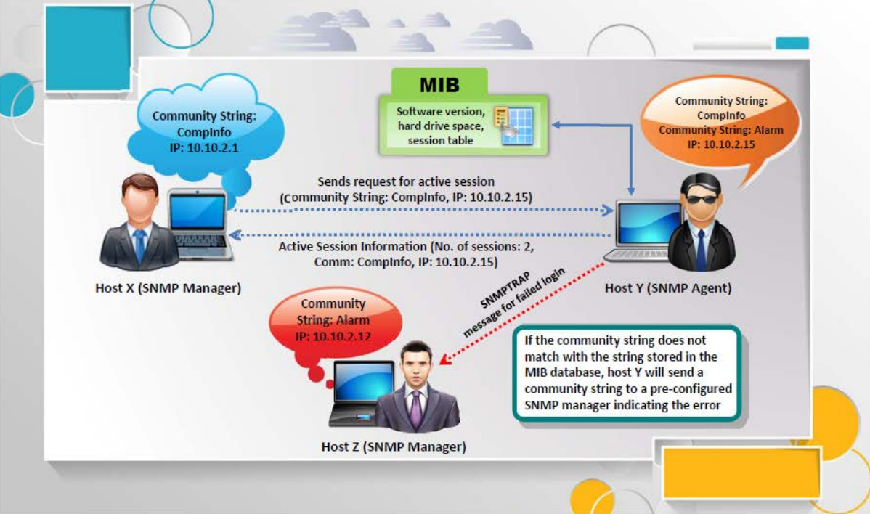
Working of SNMP

Slide 6
Management Information Base (MIB)
A virtual database containing formal description of all the network objects
It is hierarchical & each managed object is addressed through Object Identifiers (OIDs)
Types of managed objects:
  Scalar Objects - A single object instance
  Tabular Objects - Multiple related object instances
OID includes the type of MIB objects such as:
  Counter
  String or address
  Access level
  Size restrictions
  Range information
Namespace containing object identifiers(OIDs) used to translate the OID numbers into a human-readable display

Slide 7
Lightweight Directory Access Protocol
Network Time Protocol
An internet protocol for accessing distributed directory services
May provide any organized set of records like corporate email directory
Session starts by connecting to a Directory System Agent(DSA) on TCP port 389
Information is transmitted between the client & server using Basic Encoding Rules(BER)
Information gather like valid usernames, addresses & departmental details etc.
Designed to synchronize clocks of networked computers
Uses UDP port 123 as its primary means of communication
Maintain time within 10 milliseconds(1/100 seconds) over the public internet
Achieve accuracies of 200 microseconds or better in local area network
Information gathers such as:
  List of hosts connected to NTP server
  Clients IP addresses, system names & OS
  Internal IPs if the NTP server is in the DMZ

Slide 8
Simple Message Transfer Protocol (SMTP)
DNS Zone Transfer
SMTP provides 3 built-in-commands:
  VRFY - Validate users
  EXPN - Actual delivery addresses of aliases & mailing lists
  RCPT TO - Recipients of the message
Corresponding on the difference in response of built-in-commands, we can determine valid users on SMTP server
Direct interaction with SMTP via Telnet prompt & collect list of valid users
Process of locating the DNS server & the records of a target network
Gather valuable network information such as:
  DNS server name
  Hostnames
  Machine names
  Usernames
  IP addresses etc.
Tries to retrieve a copy of the entire zone file for a domain from the DNS server

Slide 9
Enumeration Countermeasures
SNMP
Remove the SNMP agent or turn of the SNMP service
Change the default community string name
Upgrade to SNMP3 for encryption
Implement Additional restrictions for anonymous connections
Access to null session pipes, null session shares & IPSec filtering is restricted
DNS
Disable the DNS zone transfer to the untrusted hosts
Private hosts & IP addresses are not to be published into DNS zone files of public DNS Server
Use premium DNS registration services
Use standard network admin contacts for DNS registration

Slide 10
Enumeration Countermeasures
SMTP
Ignore email messages to unknown recipients
Avoid including sensitive mail server & local hosts information in mail
Disable open relay feature
LDAP
Use SSL technology to encrypt the traffic
Select different username from your emails & enable account lockout
SMB
Disable SMB protocol on Web & DNS server
Disable SMB protocol on Internet facing servers
Disable ports TCP 139 & TCP 445
Restrict anonymous access through RestrictNullSessAccess parameter from the Windows Registry

Slide 11
Enumeration Pen Testing
Used to identify valid user accounts or poorly protected resource shares using active connection to system & directed queries
Collected information are:
  Users & groups
  Network resource & shares
  Applications
Used in combination with data collected in reconnaissance phase
START
Find Network Range
Calculate the Subnet Mask
Undergo Host Discovery
Perform Port Scanning
Perform NetBIOS Enumeration
Perform SNMP Enumeration
Perform LDAP Enumeration
Perform NTP Enumeration
Perform SMTP Enumeration
Perform DNS Enumeration
Document all the findings
‹#›

Slide 12
THE END

